Slide 1
Final Engagement
Attack, Defense & Analysis of a Vulnerable Network

Slide 2
Table of Contents
This document contains the following resources:
Network Topology & Critical Vulnerabilities
Alerts Implemented
Hardening
Implementing Patches

Slide 3

Network Topology
& Critical Vulnerabilities
‹#›

Slide 4
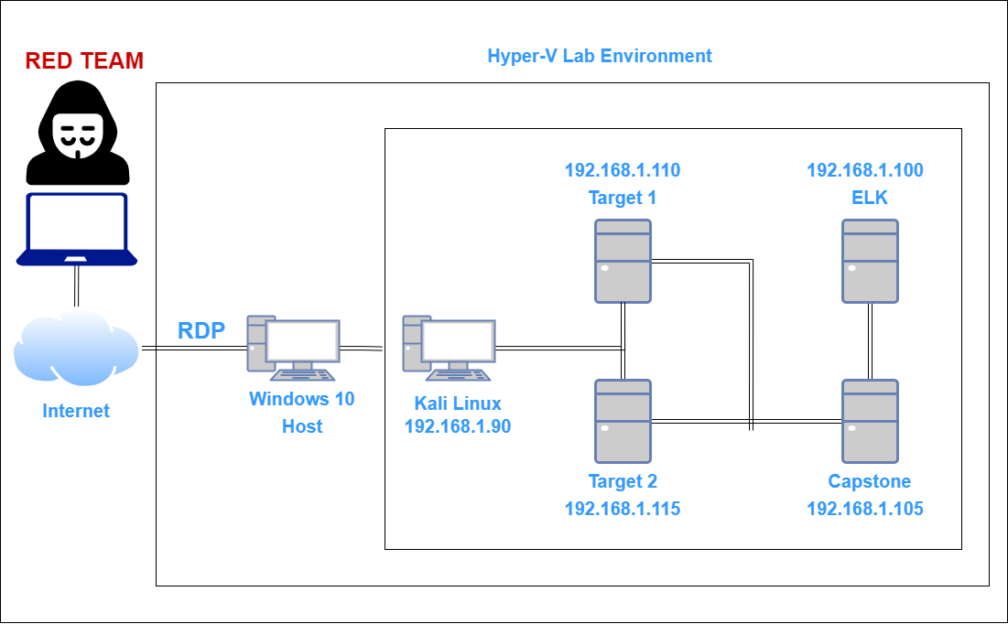
Network Topology
Network
Address Range: 192.168.1.1/24
Gateway: 192.168.1.1
Machines
IPv4: 192.168.1.90
OS: Kali Linux
Hostname: kali
IPv4: 192.168.1.110
OS: Linux
Hostname: Target1
IPv4: 192.168.1.115
OS: Linux
Hostname: Target2
IPv4: 192.168.1.100
OS: Linux
Hostname: ELK

Slide 5
Critical Vulnerabilities: Target 1
Our assessment uncovered the following critical vulnerabilities in Target 1.
Vulnerability | Description | Impact
Wordpress Core not updated | Security Patches needed | High
AntiMalware/AV | Install needed | High
No Firewall Rules | WAF needed | High

Slide 6
Alerts Implemented
‹#›

Slide 7
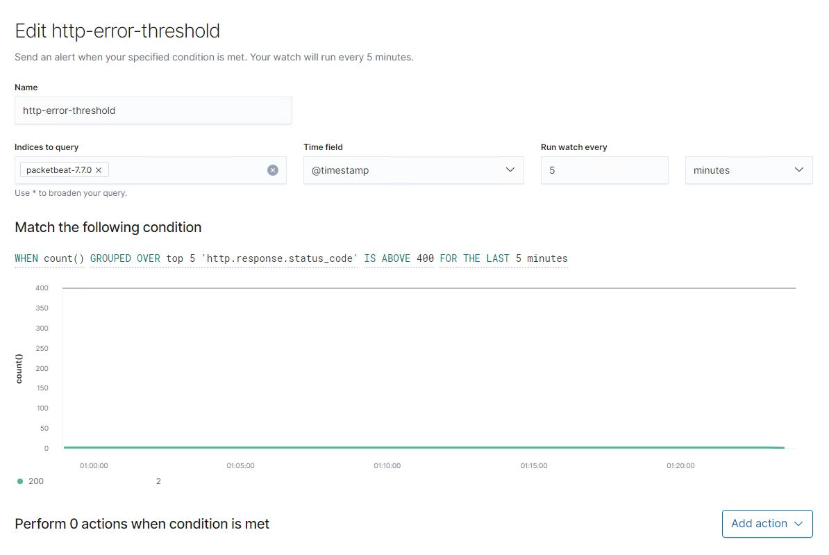
Alert 1: HTTP Error Threshold
Condition: WHEN count() GROUPED OVER top 5 ‘http.response.status_code IS ABOVE 400
Vulnerability Detected: This is alert is used to measure http error codes 400 and above. This will help in detecting attacks like Enumeration and Brute Force Attacks.

Slide 8
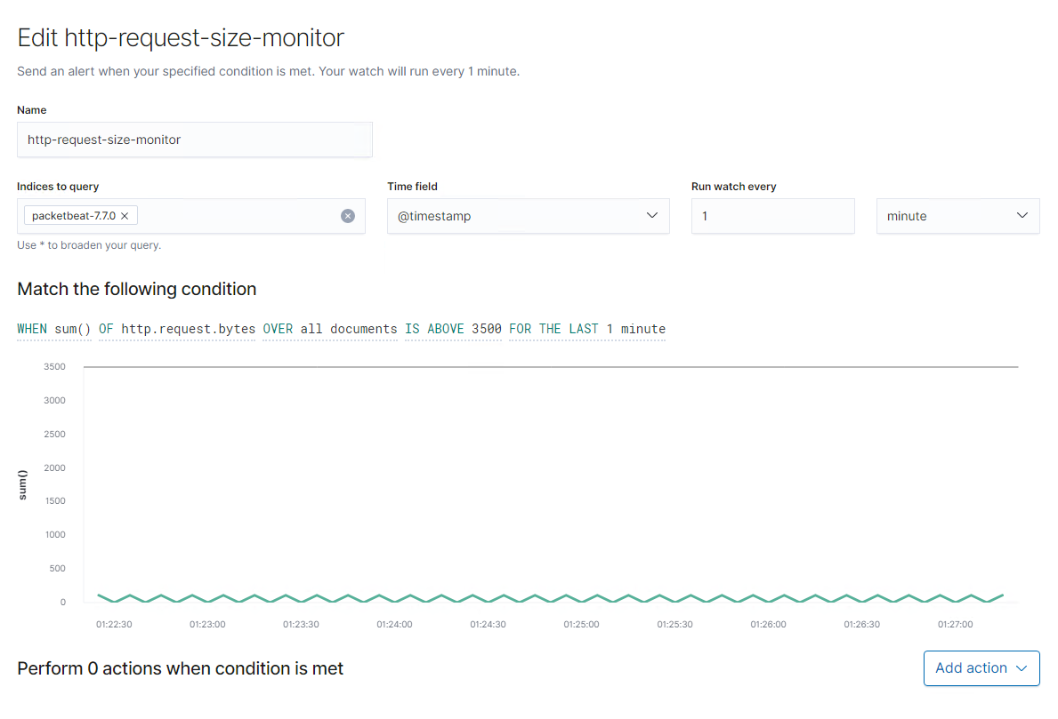
Alert 2: CPU Usage Monitor
Condition: WHEN max() of system.process.cpu.total.pct OVER all documents IS ABOVE 0.5
Vulnerability Detected: This is alert is used to measure cpu usage and can aid in detecting malware, spyware and keyloggers maliciously installed.

Slide 9
Alert 3: HTTP Request Size Monitor
Condition: WHEN sum() OF http.request.bytes OVER all documents IS ABOVE 3500
Vulnerability Detected: This alert will help detect attacks such as DDoS and Code injections like CRLF and XSS.

Slide 10
Hardening
‹#›

Slide 11
Hardening Against Wordpress Attacks on Target 1
Vulnerable Version of Wordpress
Patch: Wordpress Core updates and hardening
Why It Works: By installing latest Wordpress updates, it can fix security issues and known vulnerabilities. Also Wordpress can be hardened by using tools like Wordfence and disabling unused features and plugins. Additionally, if REST API is enabled, but not needed, WPScan takes advantage of this and is used to enumerate Wordpress. Disabling this feature can reduce this vulnerability.

Slide 12
Hardening Against Malware/Virus on Target 1
No Antivirus/Anti Malware Installed
Patch: Antivirus/Antimalware software Installation
Why It Works: High CPU usage is usually a good indicator that the device has been infected with malware or a keylogger virus/software. Having a good AV product installed on the host device can help mitigate this type of attack.

Slide 13
Hardening Against Malicious Web Traffic on Target 1
No Traffic Filtering
Patch: Deploy a WAF (Web Application Firewall)
Why It Works: WAFs are good at detecting, blocking and sanitizing HTTP traffic. Security rules can be configured to filter out specific traffic patterns that are consistent with attacks such as SQL-Injections, XSS, and DDoS.

